Slide 1
Matrix Factorizations at Scale: A Comparison of Scientific Data Analytics in Spark and C+MPI Using Three Case Studies
Gittens, Alex, Aditya Devarakonda, Evan Racah, Michael Ringenburg, Lisa Gerhardt, Jey Kottalam, Jialin Liu et al. "Matrix Factorization at Scale: a Comparison of Scientific Data Analytics in Spark and C+ MPI Using Three Case Studies." arXiv preprint arXiv:1607.01335 (2016).

Slide 2
Problem Statement
A key step to gaining insight in nearly any scientific field is data analytics
Something of a rate-limiting step
Some of the most important of these analytics strategies rely on matrix algorithms
ScaLAPACK
LAPACK
BLAS
PLASMA
MAGMA
MapReduce
Spark
Flink
?
Notes:
Ideally, the scientific data analysis and high performance computing (HPC) communities would leverage the momentum behind Hadoop and Spark.
Unfortunately, the performance of such frameworks at scale on conventional HPC hardware has not been investigated extensively. For linear algebraic computations more broadly, and matrix factorizations in particular, there is a gap between the performance of well-established libraries (ScaLAPACK, LAPACK, BLAS, PLASMA, MAGMA, etc. [4, 3]) and toolkits available in Spark.

Slide 3
Goals of the Paper
Testing nontrivial linear algebra and matrix factorization algorithms on Spark
Test on real-world, large-scale scientific data
Compare performance to C+MPI implementations on “traditional” HPC hardware
Identify bottlenecks in Spark to better address large-scale scientific data analytics on HPC platforms
Notes:
We develop parallel versions of three leading matrix factorizations (PCA, NMF, CX) in Spark and C+MPI; and we apply them to several TB-sized scientific data sets.
We conduct strong scaling tests on a XC40 system, and we test the scaling of Spark on up to 1600 nodes.
We characterize the performance gap between Spark and C+MPI for matrix factorizations, and comment on opportunities for future work in Spark to better address large scale scientific data analytics on HPC platforms.

Slide 4
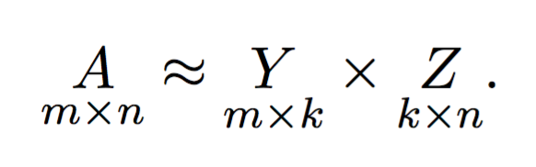
Matrix Factorization Overview
Given: n-by-m matrix, A
Find: low-rank representation of A
Two (or more) small matrices that, when multiplied, create a good approximation of A
Why?
Compression / optimization of memory use
Interpretability
Basic dimensionality reduction technique
Helpful for gaining intuition into extremely large datasets
Notes:
Matrices are TALL AND SKINNY—
The rank r is significantly smaller than n (number of data points), as is m (the number of features)
- As a row matrix, this creates a “tall and skinny” matrix format with lots of rows and relatively fewer columns

Slide 5
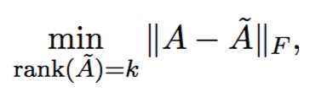
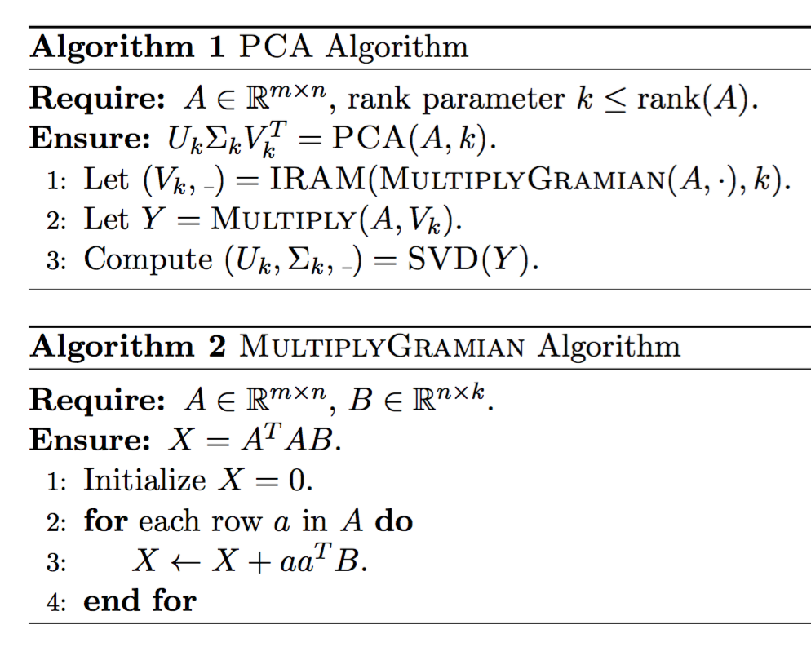
Matrix factorizations
Principal Component Analysis (PCA)
Provides best low-rank matrix approximation with respect to any unitarily invariant matrix norm
Direct computation of PCA is O(nm²), not feasible for large systems
Spark’s MLlib provides both SVD and PCA (PCA explicitly computes A^{T}A)
Notes:
Algorithm 1:
step 1, a series of distributed matrix-vector products against AT A (MultiplyGramian) are used to extract Vk by applying the implicitly restarted Arnoldi method (IRAM)
Step 2, a distributed matrix-matrix product followed by a collect is used to bring AVk to the driver
Step 3, occurs on the driver, and computes a final SVD on AVk to extract the top left singular vectors Uk and the corresponding eigenvalues Σk. Here QR and SVD compute the “thin” versions of the QR and SVD decomposition

Slide 6
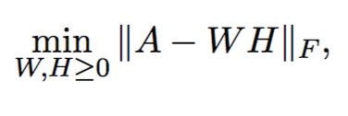
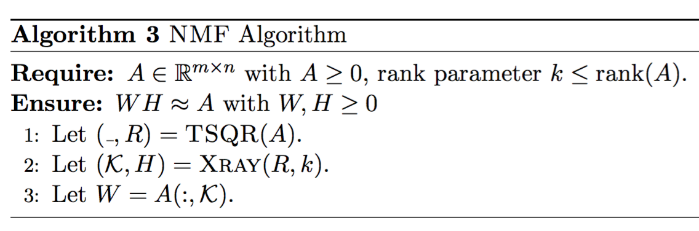
Matrix factorizations
Nonnegative Matrix Factorization (NMF)
PCA may provide optimal low-rank approximation, but some application require both sparseness and interpretability of low-dimensional basis
NMF basis vectors are additive superpositions of small number of positive factors
Spark’s MLlib provides alternating least-squares based NMF
Notes:
where W ∈ Rm×k and H ∈ Rk×n are entry-wise nonnegative matrices.
Typical approaches attempt to solve this non-convex problem by using block coordinate optimizations that require multiple passes over A
We adopt the one-pass algorithm
- This approach makes the assumption that W can be formed by selecting columns from A
- In this setting, the columns of A constituting W as well as the corresponding H can be computed directly from the (much smaller) R factor in a thin QR factorization of A
Algorithm 3:
- step 1, a one pass distributed tall-skinny QR (TSQR) factorization [11] is used to compute the R factor of A
- Step 2, which occurs on the driver, the Xray algorithm of [28] is applied to R to simultaneously compute H and the column indices K of W in A
- step 3, W can be explicitly computed once K is known.

Slide 7
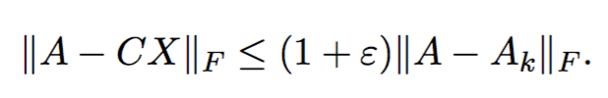
Matrix factorizations
CX factorization (CUR decomposition)
Low-rank approximation expressed in terms of a small number of actual rows or columns, rather than eigenvectors or principal components
Results in most interpretable basis (genetics, astronomy, mass spec imaging)
Algorithm takes leverage scores as input
Defined in terms of the matrix of top-k right singular vectors, V_{k}
CX algorithm uses these scores as a sampling distribution to select k columns
Computational cost of CX algorithm is determined by cost of computing V_{k}
Notes:
we seek matrices C and X such that the approximation error ∥A − CX∥F is small and C is an m × k matrix comprising of k actual columns of A and X is a k × n matrix.
To approximate Vk, we use the RandomizedSVD algorithm (from Martinsson, Rohklin, and Tygert 2011, tech report in 2006)

Slide 8
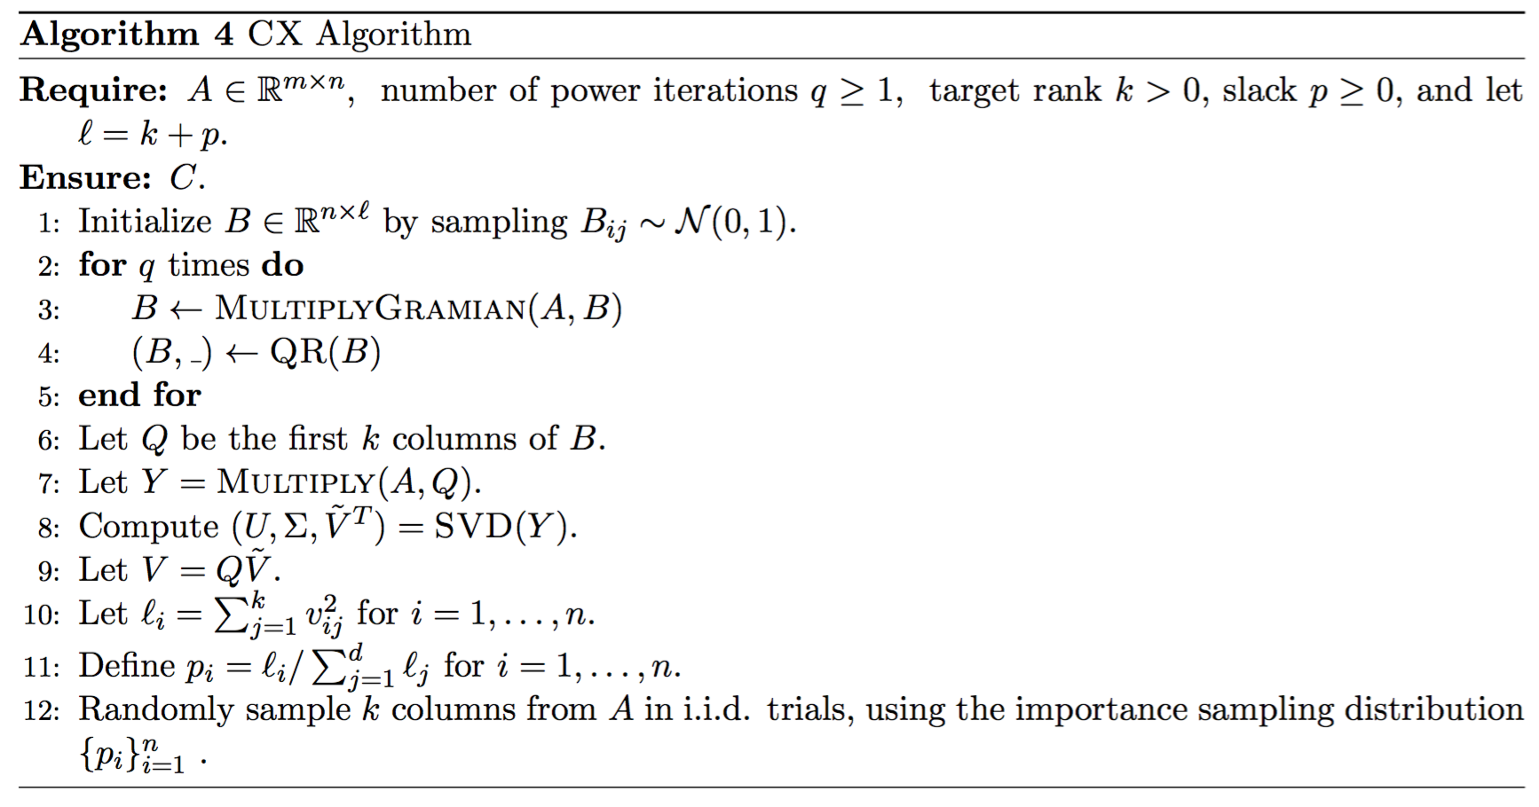
Matrix factorizations
Notes:
Importantly, the algorithm runs in O(mn log k) time and needs only a constant number of passes over the data matrix (q+1), where q is number of power iterations
- The RandomizedSVD algorithm comprises the first nine steps
The running time cost for RandomizedSVD is dominated by a distributed matrix- matrix multiplication appearing in Steps 3 and 7
After Step 7, Y is collected the remaining computations are carried out on the driver.

Slide 9
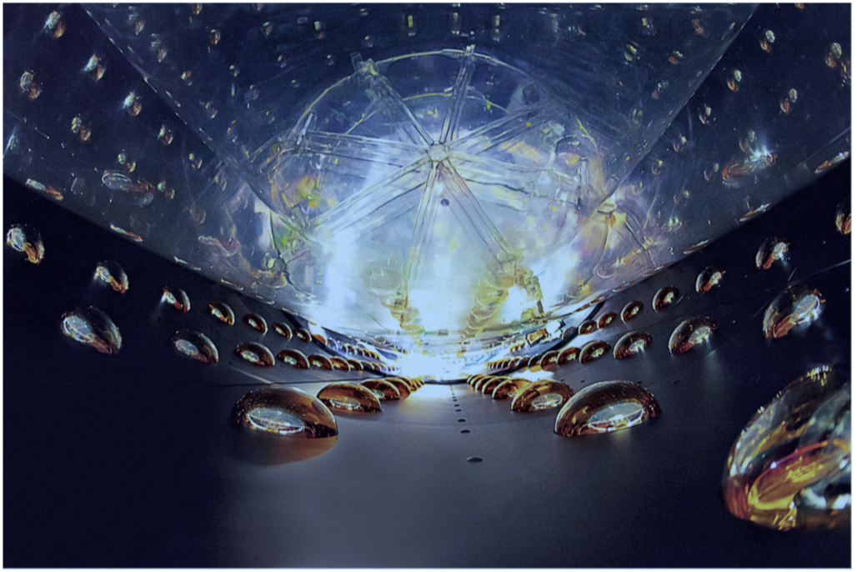
Datasets
Daya Bay Neutrino Experiment
Detects antineutrinos produced by Ling Ao and Daya Bay nuclear power plants
Uses detections to measure theta-13, a fundamental constant that describes oscillation pattern of neutrinos
Sparse 1.6TB matrix of photomultiplier detections
Notes:
Good candidate for NMF, since detections can never be negative

Slide 10
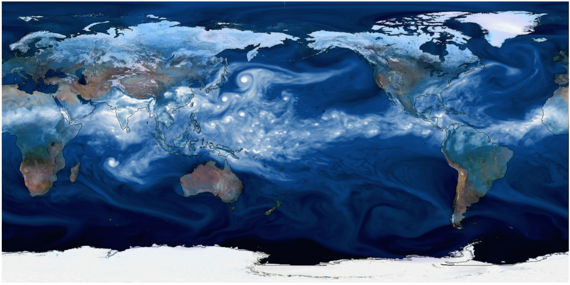
Datasets
Climate Forecast System Reanalysis Project
Global ocean temperature data, spatially resolved at 360 x 720 x 41 (lat x long x depth) and 6-hour temporal resolution: dense 2.2TB matrix
CAM5 0.25-degree atmospheric humidity data, grid of 758 x 1158 x 30 (lat x long x height) and 3-hour temporal resolution: dense 16TB matrix
Notes:
Good candidate for PCA, to extract patterns in temperature and humidity fluctuations

Slide 11
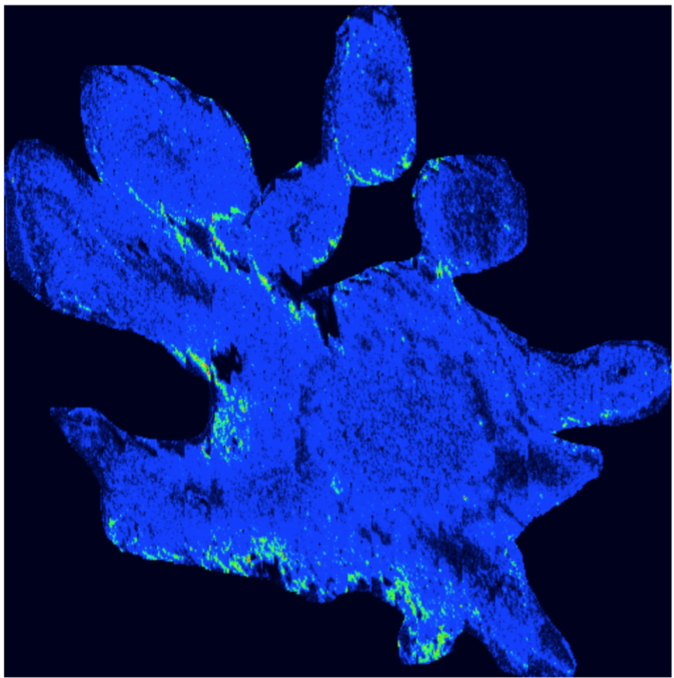
Datasets
Mass-Spectrometry Imaging
Measures ions derived from molecules present in a biological sample
Think spectral analysis for proteins
Spectra of the ions acquired at each location (pixel) are resolved spatially
Plant sample of Lewis Dalisay Peltatum: sparse 1TB matrix of ion values at each pixel
Notes:
Good candidate for CX decomposition, as CX decompositions allow for the possibility of identifying small numbers of columns (ions) in the original data that reliably explain a large portion of the variation in the data

Slide 12
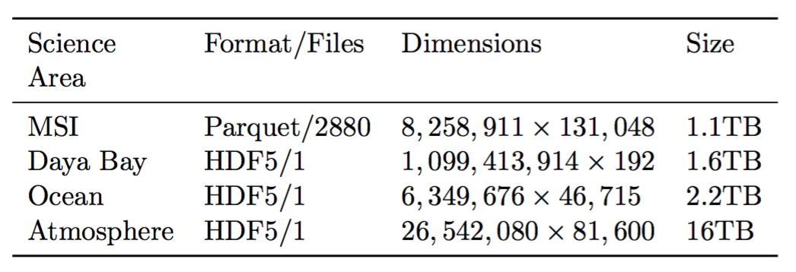
Datasets

Slide 13
Setup
Spark
C+MPI
RDDs
Row-partitioned format
MultiplyGramian is core of all three decomposition methods
Requires only 1 round of communication
Local linear algebra primitives use LAPACK bindings in Breeze
Netlib-Java binding in ARPACK supplies IRAM primitive for PCA
Data matrices represented as 1D arrays of double-precision floats
Partitioned across nodes using block-row partitioned format
TSQR used as main computational library
MPI collectives for inter-processor communication
I/O is independent, using Cray HDF5 parallel I/O library
Notes:
We use the Standalone Cluster Manager to run the Spark cluster
We utilized the H5Spark package to read HDF5 data in as one RDD object

Slide 14
Setup
Cray XC40 system
1,632 dual-socket compute nodes
Each node has two 2.3GHz 16-core Haswell processors
Each node has 128GB of DRAM
Cray Aries high-speed interconnect is configured in “Dragonfly” topology
Lustre scratch filesystem with 27PB of storage
700 GB/s peak I/O performance

Slide 15
Tuning Parameters
Spark
C+MPI
Shifter writable temporary space, private to each node, for simulating local disk
Driver and executor: 100 GB
Turned off speculation
Spark locality wait: 2 minutes
1-to-1 correspondence between Spark cores and physical cores
KryoSerializer
Compiled Spark using multi-threaded OpenBLAS
NMF algorithm uses Tall-Skinny QR (TSQR) as part of Communication-Avoiding Dense Matrix Computations (CANDMC) library
Links to Intel MKL for optimized BLAS routines using Fortran libraries
Flat-MPI configuration with one MPI process per physical core
Disabled TurboBoost

Slide 16
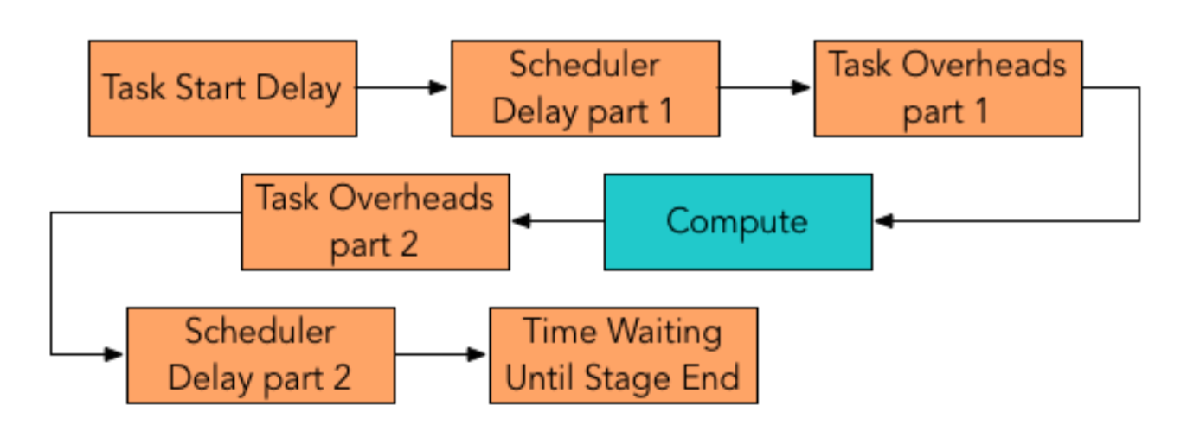
Spark Overheads
Notes:
Task Start Delay: the time between the stage start and when the driver sends the task to an executor.
Scheduler Delay: the sum of the time between when the task is sent to the executor and when it starts deserializing on the executor and the time between the completion of the serialization of the result of the task and the driver’s reception of the task completion message.
Task Overhead Time: the sum of the fetch wait times, executor deserialize times, result serialization times, and shuffle write times.
Time Waiting Until Stage End: the time spent waiting on the final task in the stage to end.

Slide 17
Results
SPARK BEATS MPI!!!1
…not

Slide 18
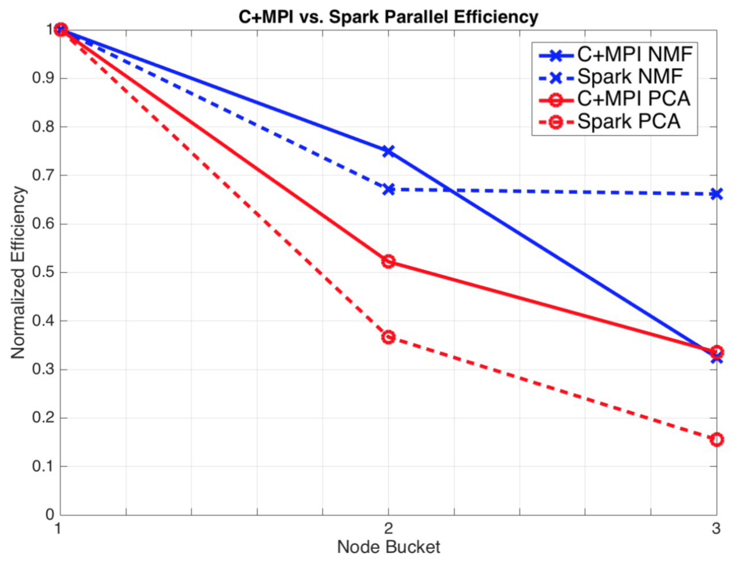
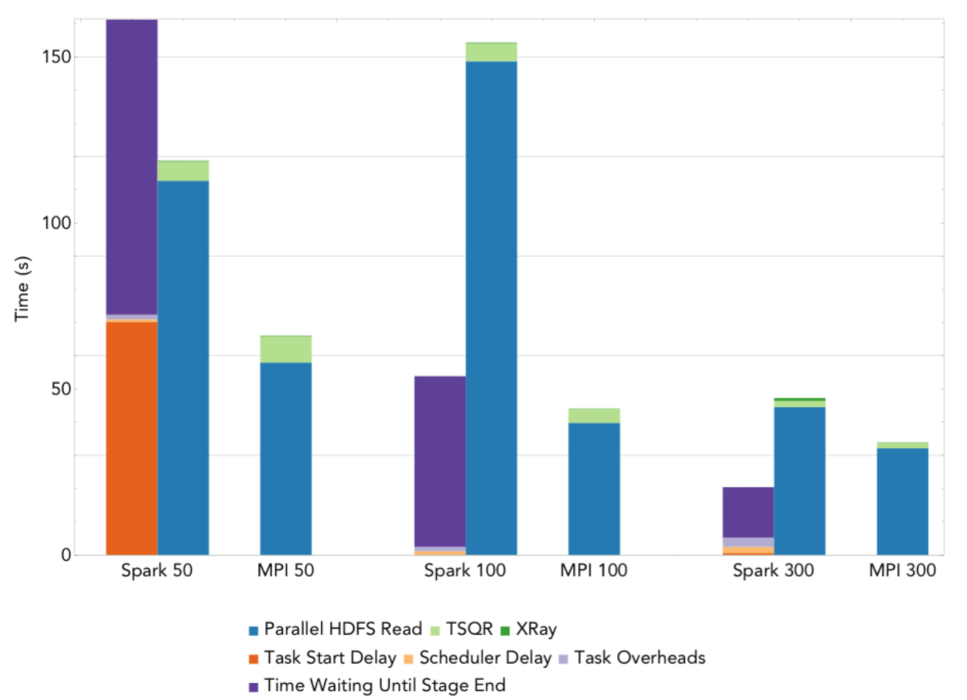
Results
NMF on Daya Bay matrix
Efficiency, normalized to 50 node runtime of both frameworks (x = 1)
Notes:
NMF matrix is 1.6TB
The TSQR algorithm used performs a single round of communication using a flat binary tree. Because there are few columns, the NMF algorithm is entirely I/O-bound
The running time for NMF is overwhelmingly dominated by reading the input. In comparison, TSQR and XRay have negligible running times
Running time breakdown when using NMF to compute a rank 10 approximation to the 1.6TB Daya Bay matrix at node counts of 50, 100, and 300. Each bin depicts the sum, over all stages, of the time spent in that bin by the average task within a stage. The 50 node run uses double the number of partitions as physical cores due to out-of-memory errors using fewer partitions– this results in a large task start delay.
Spark shows strong scaling overall, despite ~4x performance gap between Spark and MPI.

Slide 19
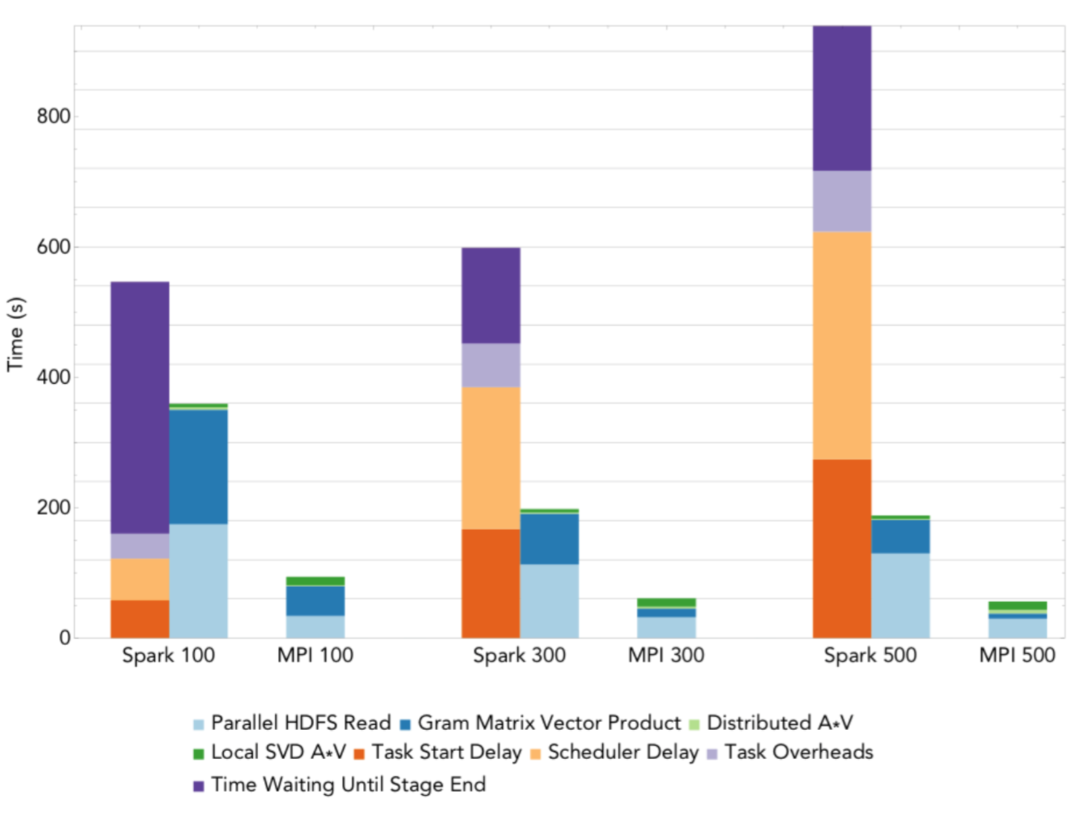
Results
PCA on climate data
Notes:
Weather matrix is 2.2TB
I/O is a significant bottleneck and does not exhibit the scaling observed for NMF
- The Gram matrix-vector products are a significant portion of the running time but scale linearly with the number of nodes.
- The matrix-matrix product (AV ) does not scale due to a communication bottleneck
- The bottleneck is because we compute a rank-20 PCA which makes communicating V expensive
- This cost grows with the number processors since it is entirely latency dominated
- The final SVD of AV is a sequential bottleneck and does not scale. Unlike NMF the sequential bottleneck in PCA is significant; future implementations should perform this step in parallel
The iterative nature of the PCA algorithm stresses the Spark scheduler since many tasks are launched during each iteration
We observed that the MPI version hits an I/O bottleneck, a communication bottleneck in the AV product and a sequential bottleneck in SVD(AV ). All of these are limiting factors and introduce inefficiencies to MPI PCA. Spark PCA is less efficient than MPI PCA due to scheduler delays, task overhead and straggler effects

Slide 20
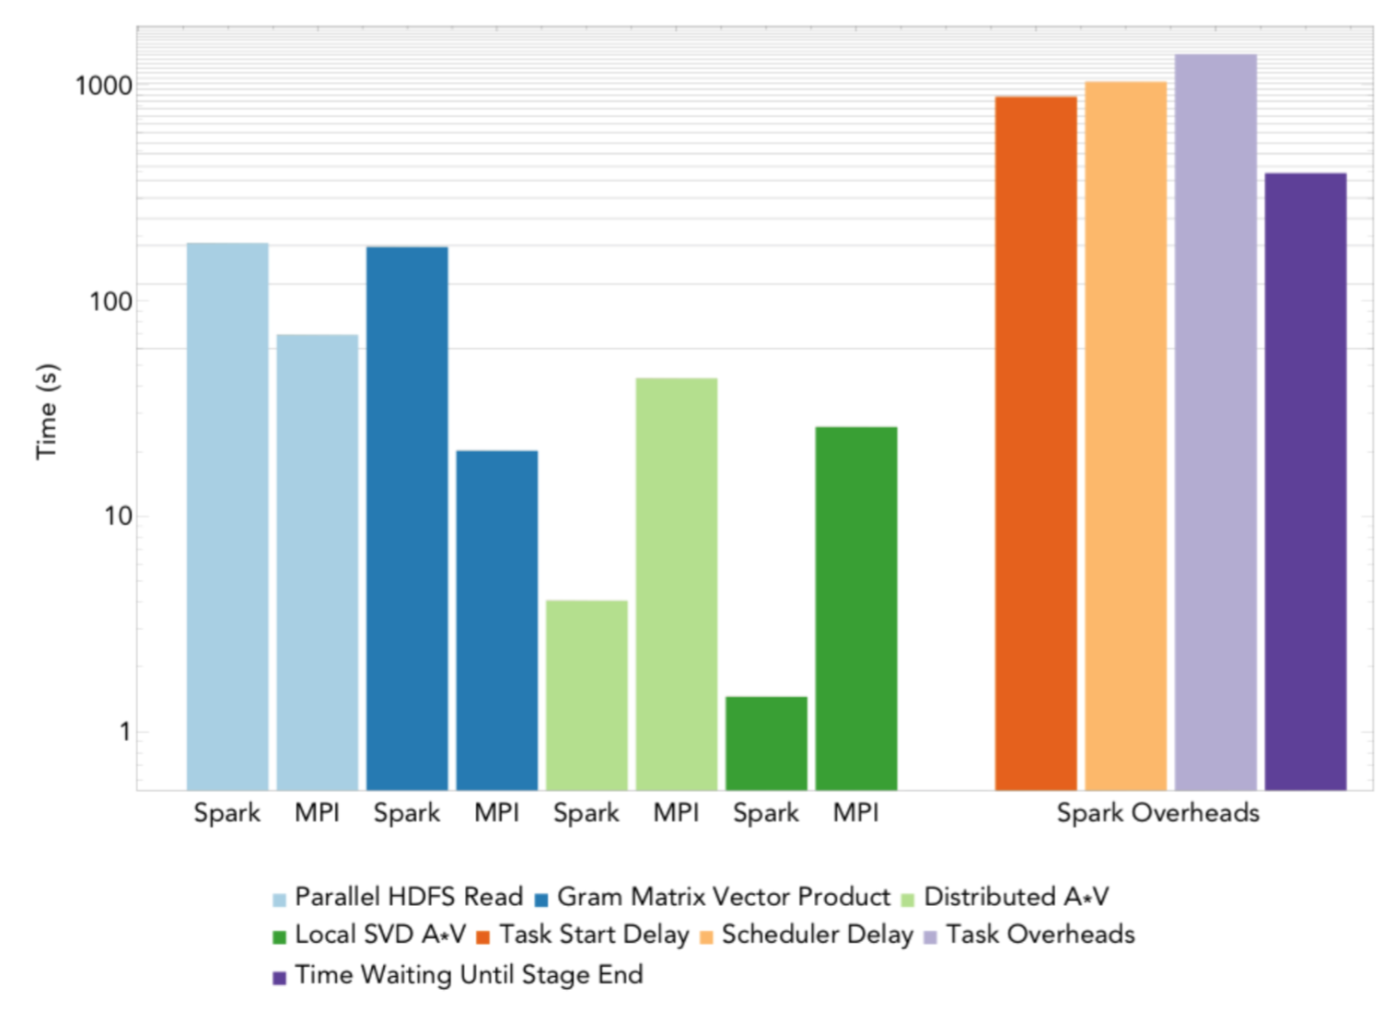
Results
PCA on atmospheric data
Notes:
Atmospheric data is 16TB
We used all 1600 Cori nodes to compute a rank-20 PCA decomposition of the 16TB Atmosphere matrix.
- we fixed the number of iterations for the EVD of AT A to 70 iterations
MPI PCA was able to complete this run in 160s
Unfortunately we were unsuccessful at launching Spark on 1600 nodes; after many attempts we reduced the number of nodes to 1522. At this node count, Spark PCA successfully completed the run in 4175s
The AV product and SVD are much faster in Spark than in MPI due to limited profiling granularity
Finally, we observed that the Spark overheads were an order of magnitude larger than the communication and computation time.

Slide 21
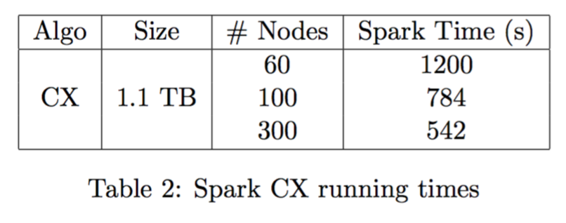
Results
CX on mass-spec data
Notes:
Mass-spec matrix is 1.1TB
We found that Spark exhibited good scaling for the range of nodes tested and attained speedups of 1.5× and 2.2× on 100 and 300 nodes, respectively.
These results show that the behavior of CX is similar to that of PCA, which is due to the overlap in their linear algebra kernels.

Slide 22
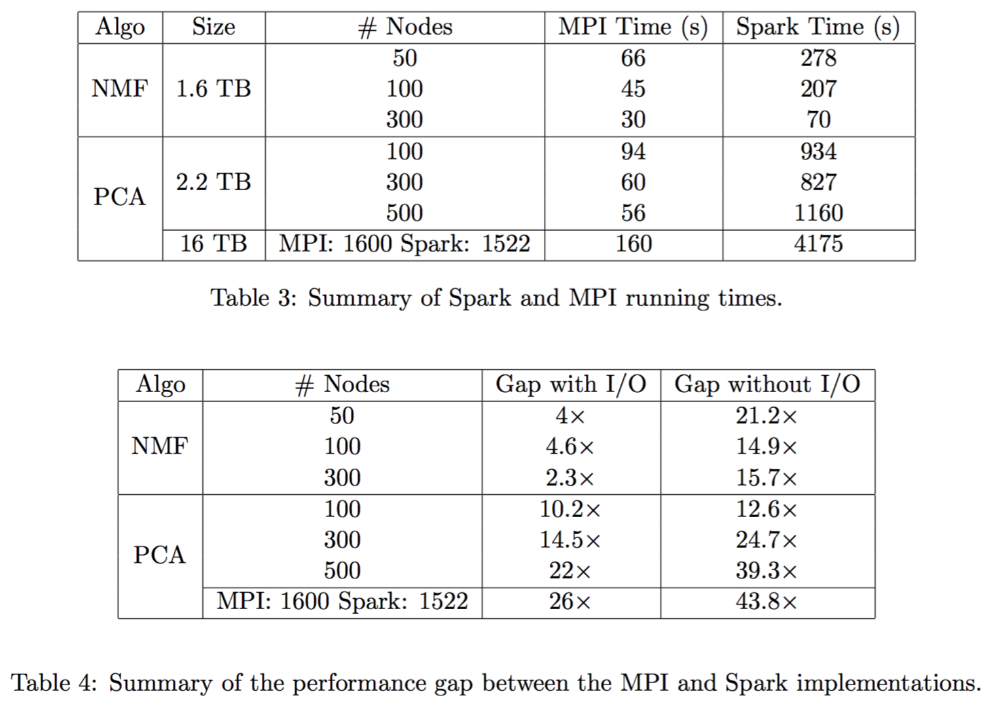
Results
Notes:
Table 3 summarizes the wall-clock times of the MPI and Spark implementations of the considered factorizations
Table 4 summarizes the performance gaps between Spark and MPI. These gaps range between 2 × −25× when I/O time is included in the comparison and 10 × −40× when I/O is not included. These gaps are large, but our experiments indicated that Spark I/O scaling is comparable to MPI I/O scaling, and that the computational time scales.
performance gaps are due primarily to scheduler delays, straggler effects, and task overhead times. If these bottlenecks can be alleviated, then Spark can close the performance gap and become a competitive, easy-to-use framework for data analytics on high-performance architectures.

Slide 23
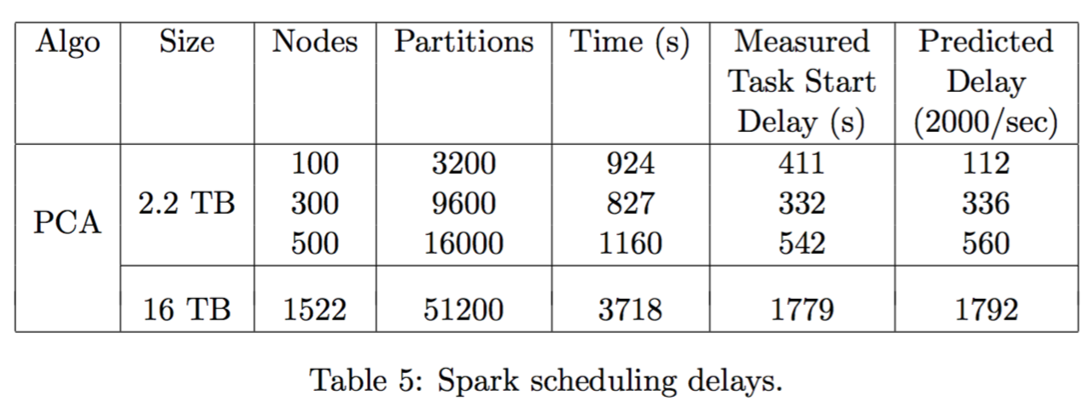
Spark Scheduling Bottlenecks
Spark driver creates and sends tasks serially, causing bottlenecks at high concurrency
Task Start Delay: time from start of stage until task is sent to executor
Scheduler Delay: additional time until driver receives confirmation task was received and execution has started
Notes:
The Measured Task Start Delay column shows the sum of the largest task start delays in each Spark stage
The Predicted Delay column shows the delay predicted by a scheduling rate of 2000 tasks per second over 70 iterations and the listed number of tasks/partitions.
We observe that at 300, 500, and 1522 nodes, the task start delay is very close to the predicted value.
This bottleneck represents a limit on the scaling achievable by Spark for highly iterative algorithms.
- as the amount of parallelism increases, the minimum number of partitions and tasks also increases
- results in a linearly increasing overhead from the scheduler as we increase parallelism
- delay is further multiplied by the number of iterations (final column is lower bound on how fast we can execute at the given scale)

Slide 24
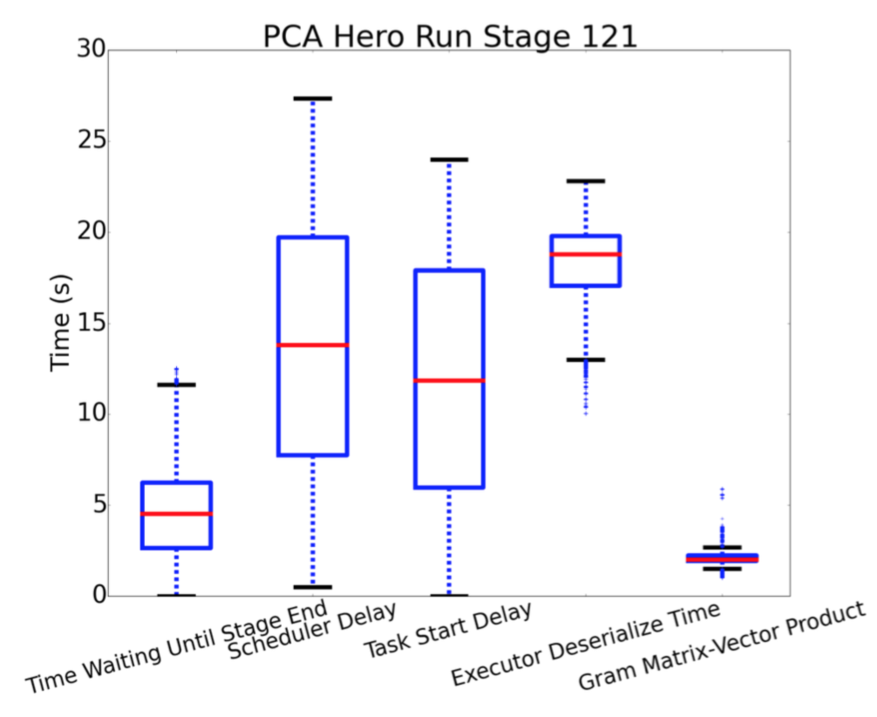
Spark Overheads
Distribution of time spent in components of task for multiplying the Gramian in Spark PCA
Executor deserialize time is consistently large
Usually attributable to large tasks that take time to unpack
Time spent in garbage collection also counts toward deserialization

Slide 25
Spark Variability and Stragglers
Bulk-synchronous execution model of Spark creates scaling issues in presence of stragglers
Variations in wait time as large as 25%; could not be attributed to any particular Spark stage
Spark has “speculation” functionality that aims to mitigate this variability by restarting straggling tasks on a new executor
Empirical findings showed no improvement in performance, as overhead in fetching the portion of the RDD needed from another worker was very high
Would have to wait for those workers to finish their own tasks first
Can result in delays as long as the run time of the straggling task
Notes:
many cores waste cycles idling at synchronization barriers. At larger scales, we see increases in both the probability of at least one straggler, as well as the number of underutilized cores waiting at barriers.
median run time of 645 seconds, a minimum run time of 489 seconds, and a maximum run time of 716 seconds
Sometimes the delay would occur in the multiply Gramian step, other times in the initial data collect stage ; illustrated as the box and whiskers plot

Slide 26
Conclusions
Comparisons reveal multitude of opportunities for improving Spark performance in large-scale scientific computing
Spark performance associated with scheduling, stragglers, and serialization/deserialization dominate runtime by an order of magnitude
May be worthwhile to investigate mechanisms for interfacing and integrating MPI-based runtimes with Spark (copy penalties between runtimes may not be prohibitive, given performance gains)
Efficient, parallel I/O is critical for scalable data analytics

Slide 27
References
Gittens, Alex, Aditya Devarakonda, Evan Racah, Michael Ringenburg, Lisa Gerhardt, Jey Kottalam, Jialin Liu et al. "Matrix Factorization at Scale: a Comparison of Scientific Data Analytics in Spark and C+ MPI Using Three Case Studies." arXiv preprint arXiv:1607.01335 (2016): https://arxiv.org/pdf/1607.01335
Spark Docker image used in experiments: https://hub.docker.com/r/lgerhardt/spark-1.5.1-openblas/

